Slide 1
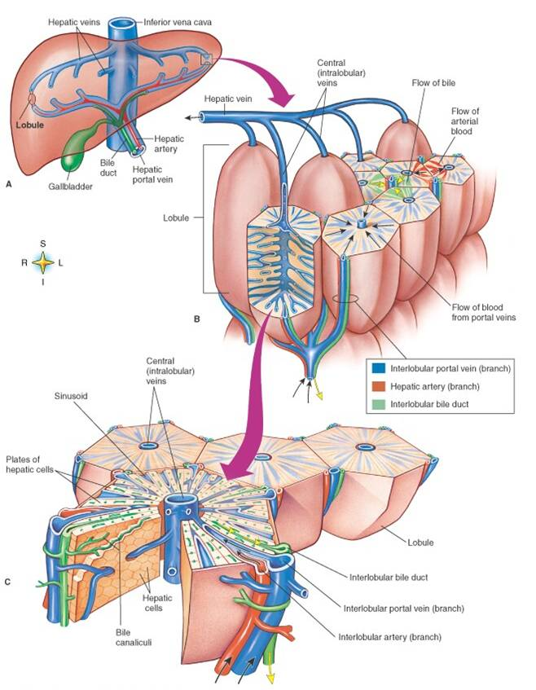
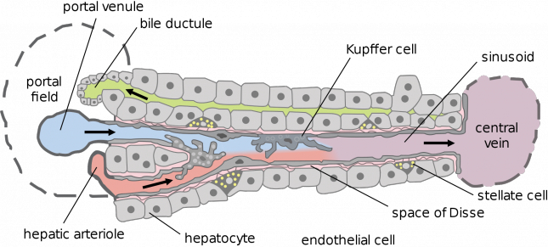
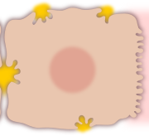
Liver Architecture IN A NUTSHELL
Liver
liver structured in parallel subunits (liver lobulus)
lobulus consists of network of sinusoids connecting hepatic artery & portal vein with the central vene (periportal → perivenous)
Sinusoidal Unit central blood vessel (sinusoid) surrounded by hepatocytes
Lobulus
Sinusoidal Unit
Hepatocyte

Slide 2



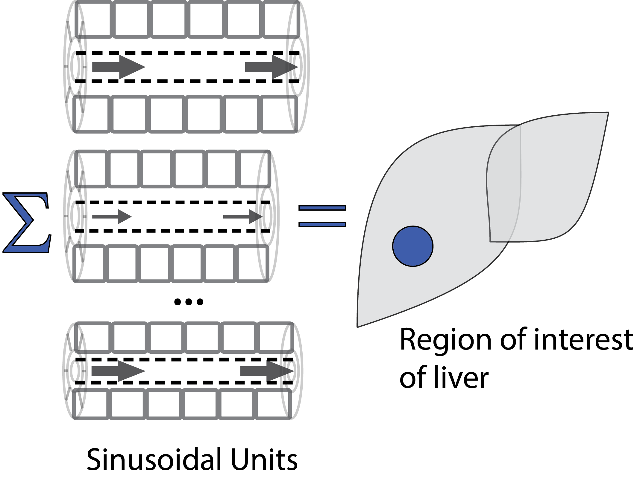
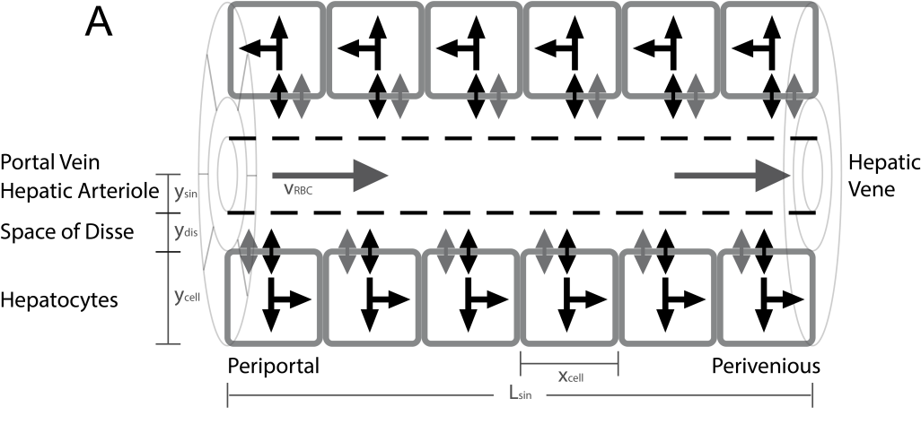
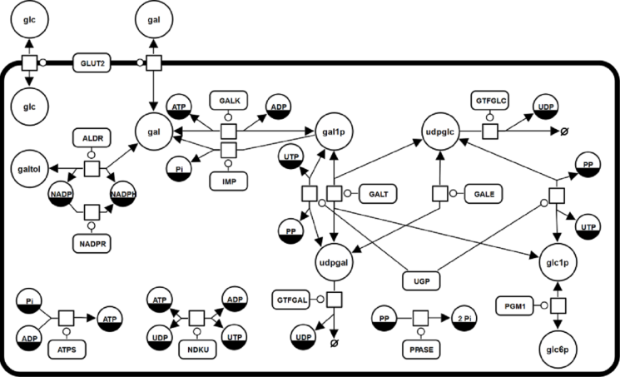
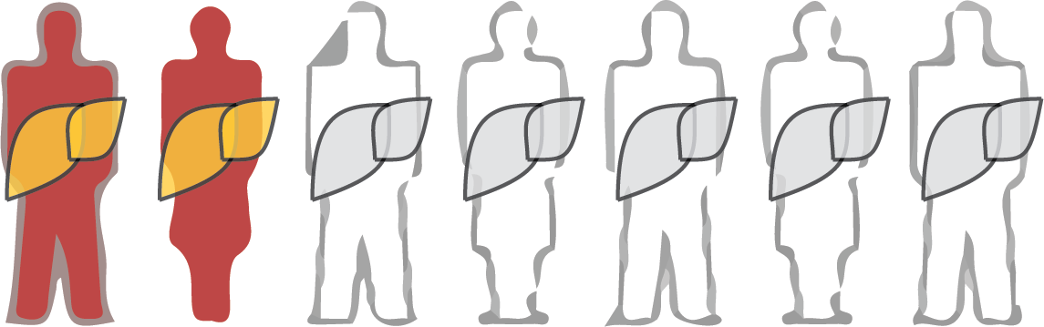
Population Variability in Liver Function König M. & Holzhütter HG.
Sinusoidal Unit
Lobulus
Hepatocyte
Individuals / Population

Slide 4


Acknowledgements
Concept & Modeling
Prof. Holzhütter
Experimental Partners
Prof. Vilstrup, Prof. Marchesini
Prof. Wang, Dr. Wynne, Dr. Heinemann
SBML & SED-ML
Frank Bergmann, Lucian Smith, Mike Hucka, Sarah Keating
SABIO-RK & data management
Martin Golibiewski
Wolfgang Müller
Renate Wittig
Funding
Charité
Virtual Liver Network

Slide 5
Workflow
MODEL
Kinetics for Cellular Processes
Literature & Database research
Organ/Patient constraints
Global rates (blood flow, volume, clearance rates, dilution curves)
Cellular Process
SIMULATION
Liver
Algorithm
Method (ODE, SS, MCA)
Algorithm parameters
SED-ML
Single Cell Model
Fitting parameters to single cell data (constraints for sinusoidal unit/liver)
SBML
DATA
MANAGEMENT
POSTPROCESSING
ANALYSIS
VISUALIZATION
Cell
Database storage
Model, algorithm, sampling, events
Timecourses
Reproducibility
+
Simulation
ODE System
C++/LSODA
COPASI
Integration
Scaling to whole liver
Visualization
Sampling Sinusoidal Unit Architectures
Representative samples
SBML
Tissue
Timecourse Events
Additional boundary conditions (peaks, altered parameters, metabolic effects)
Tissue Distribution
Parameter Distributions
Literature research
Fit to data
Notes:
<number>

Slide 6

Cellular Galactose Metabolism
liver most important organ for whole-body metabolism and clearance of galactose (>95%)
Galactose elimination capacity (GEC) measurement for functional liver cell mass
Galactose clearance altered in most liver diseases (metabolic & structural)
Galactosemias
Cirrhosis
Hepatitis
Partial hepatectomy & regeneration
Aging
…
Detailed kinetic model
ODEs for all processes involved in galactose metabolism
SBML

Slide 7
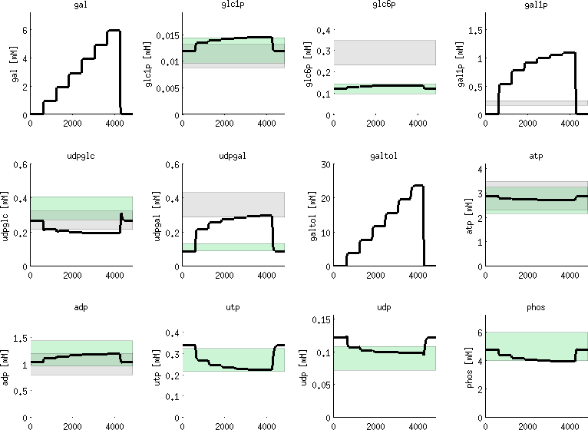
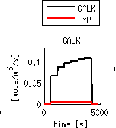
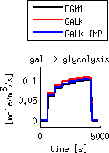
Hepatocyte Model
Reproduces
concentrations normal state & in galactose challenge
saturation of galactose clearance
effects of galactosemias
concentrations [mM]
time [s]

Slide 8
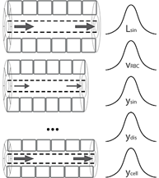
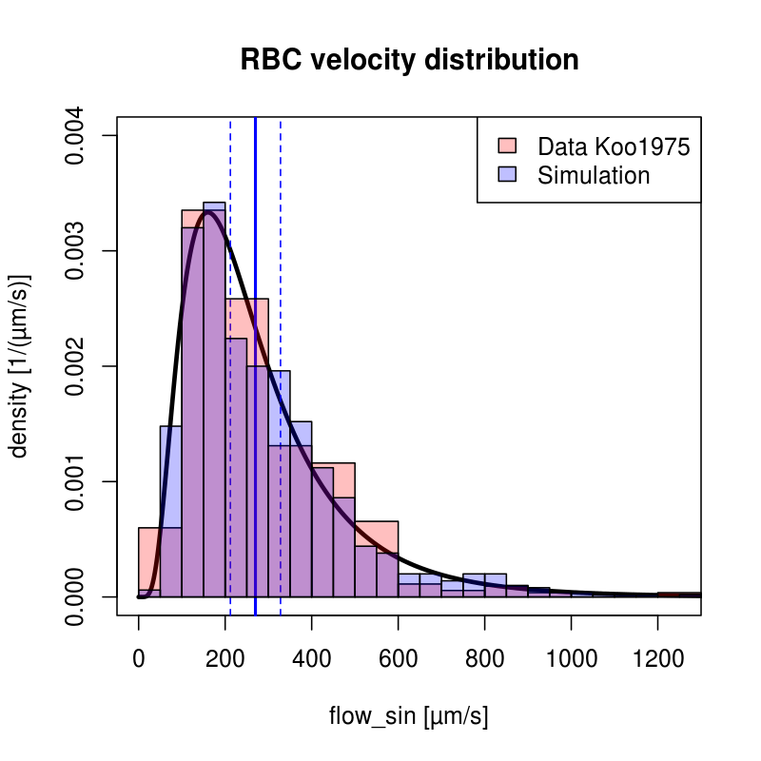
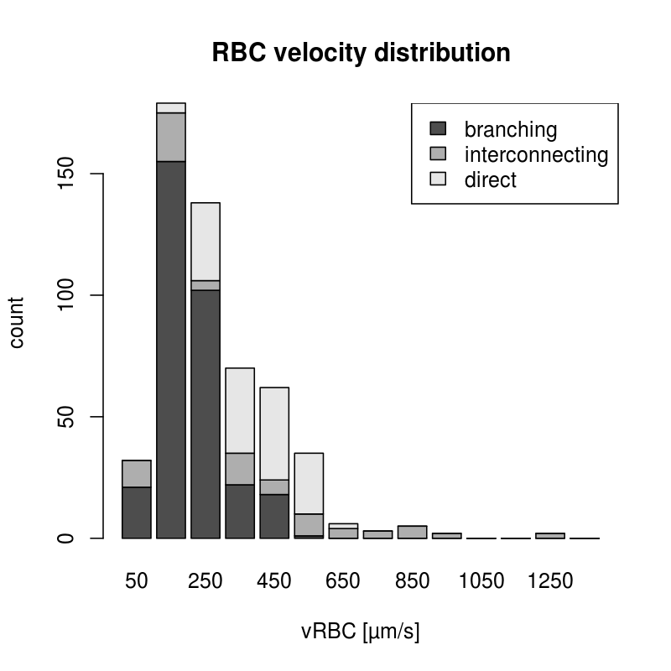
Tissue Distributions
Fitting distribution of tissue parameters via maximum-likelihood methods

Slide 9
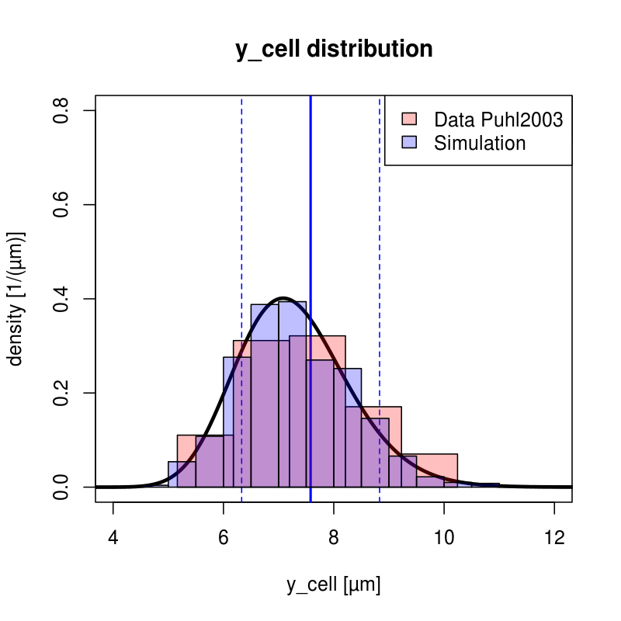
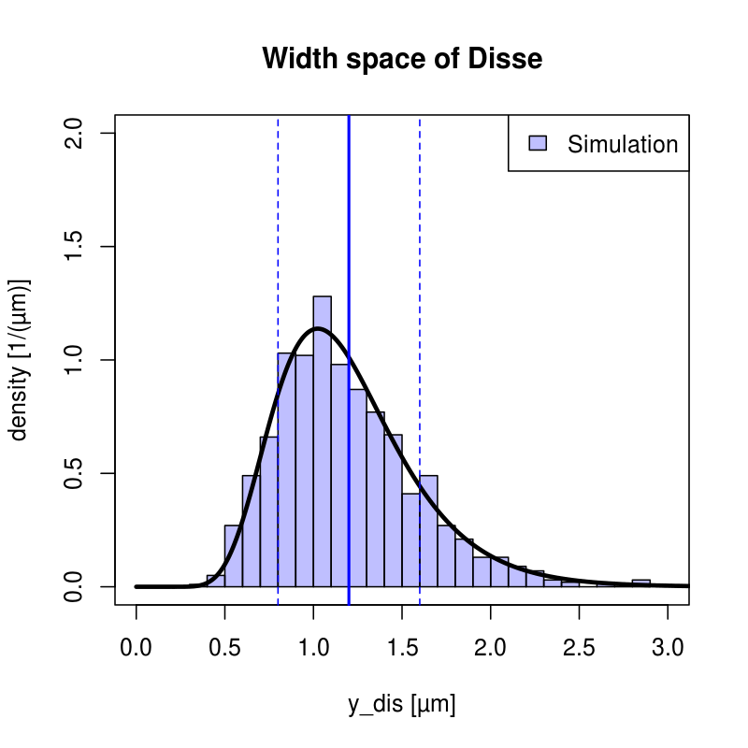
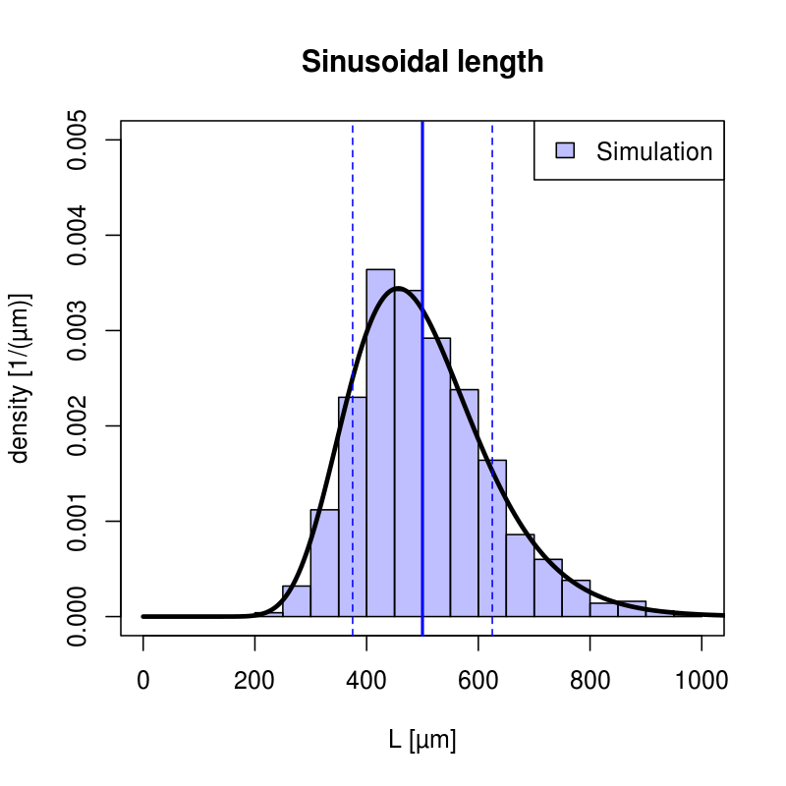
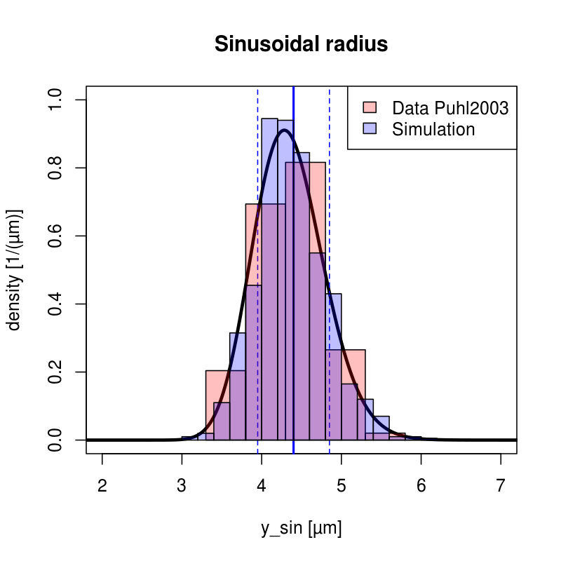
Tissue-scale Sinusoidal Unit

Slide 10
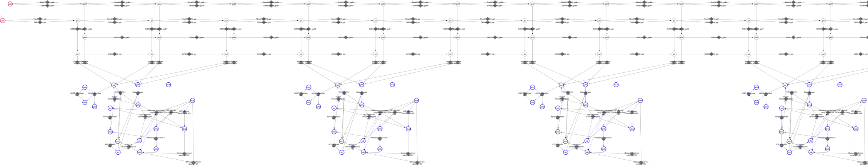
MultiTude of Large-scale ODE MODELS
Hepatocyte 1
Hepatocyte 2
H1
H20

Slide 11
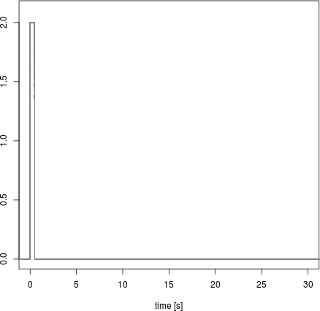
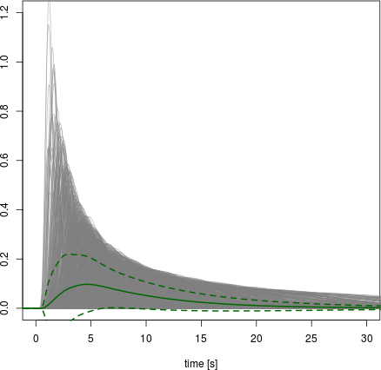
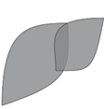
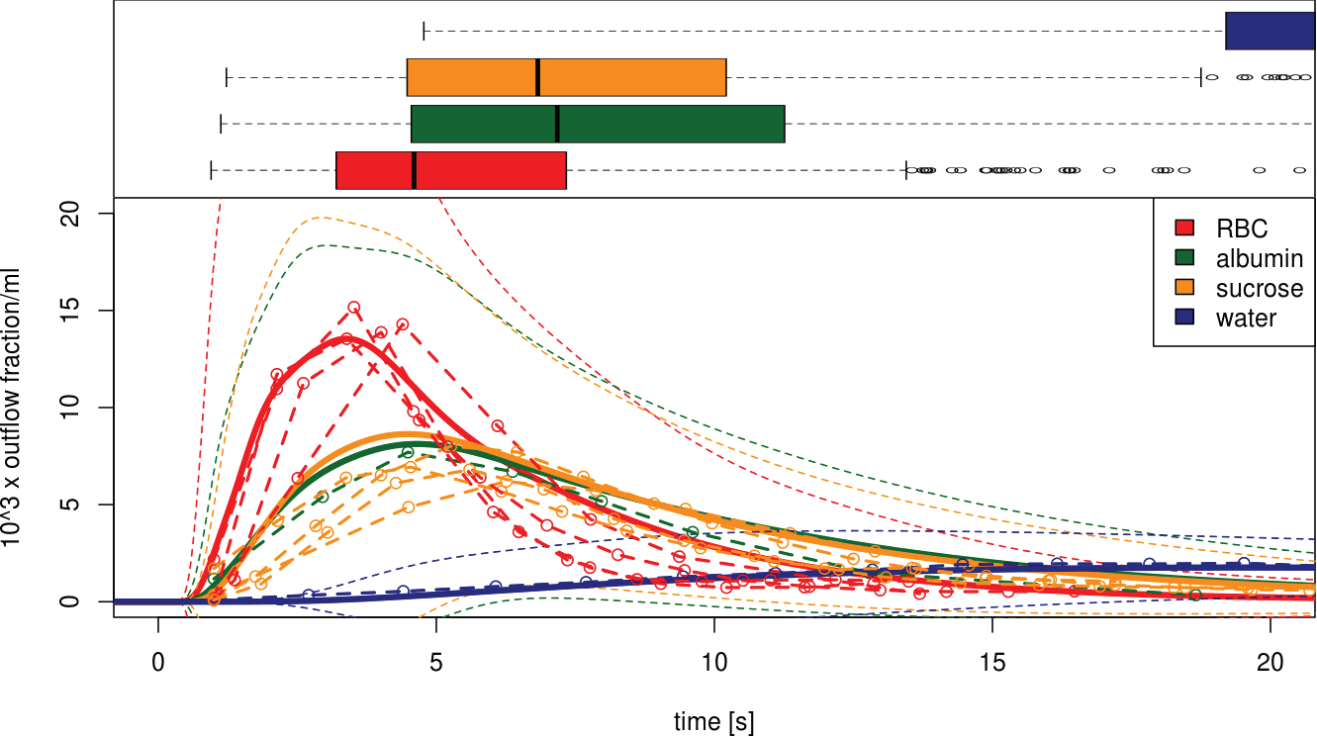
Multiple Indicator Dilution
Periportal tracer
Perivenious tracer
Boxplot
maximum times
time [s]
time [s]
Dilution curves
with experiments
time [s]
No fitting! No free parameters!

Slide 12
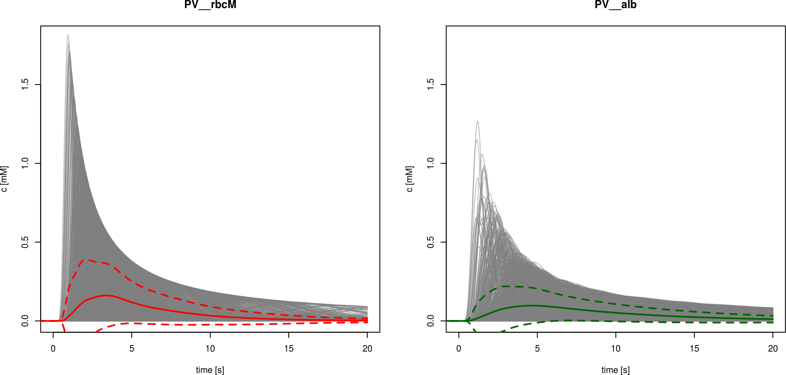


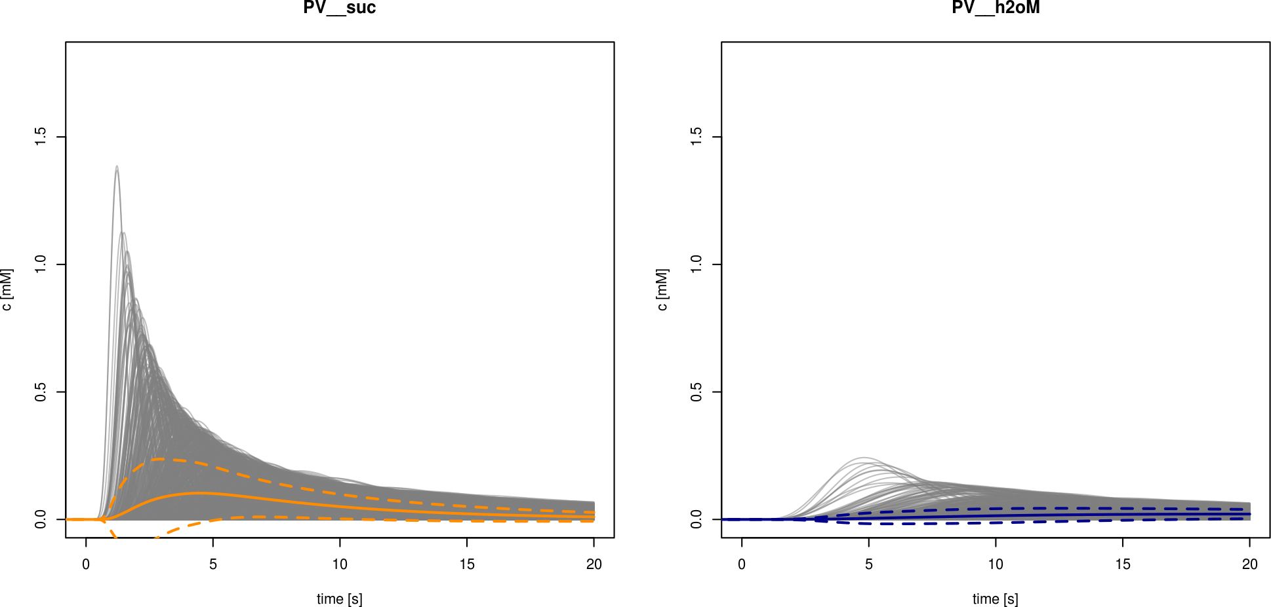

Extreme heterogeneity (!)
Local blood flow & tissue architecture
Strong effects on
Drug clearance
Metabolic function
Signalling
…
Concentrations [mM]
time [s]

Slide 13
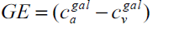
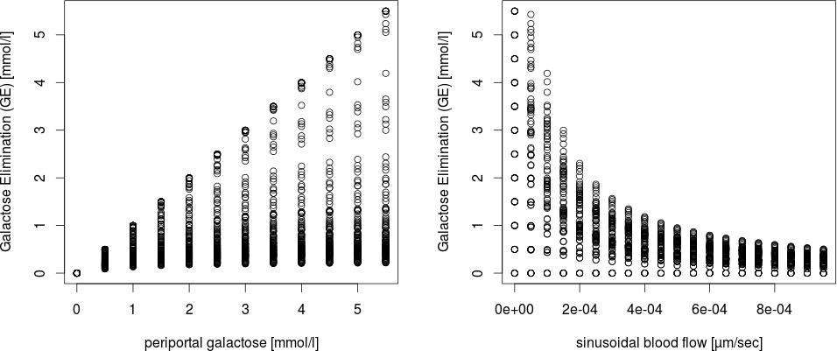
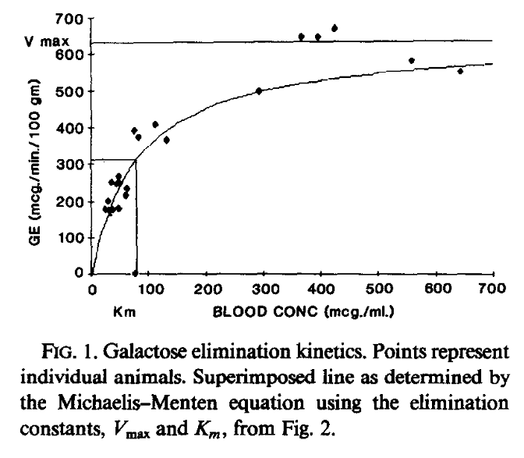
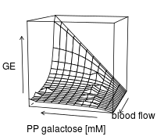
Galactose Elimination (GE)

Slide 14
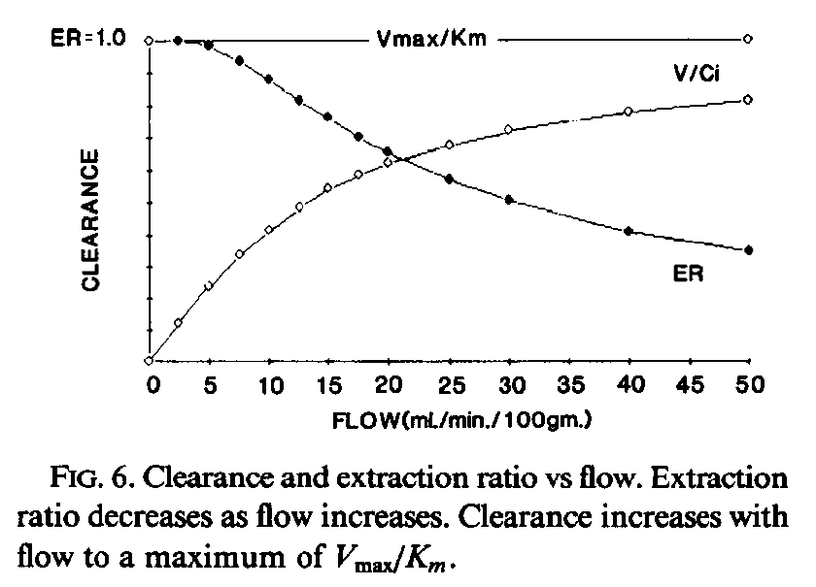
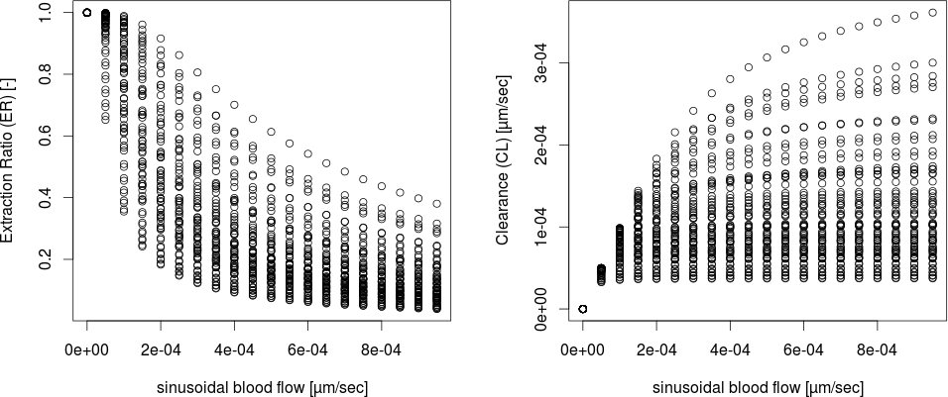
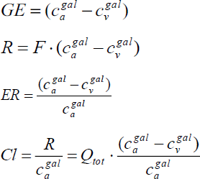
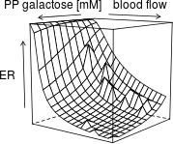
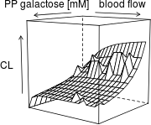
Extraction (ER) & Clearance (CL)

Slide 15
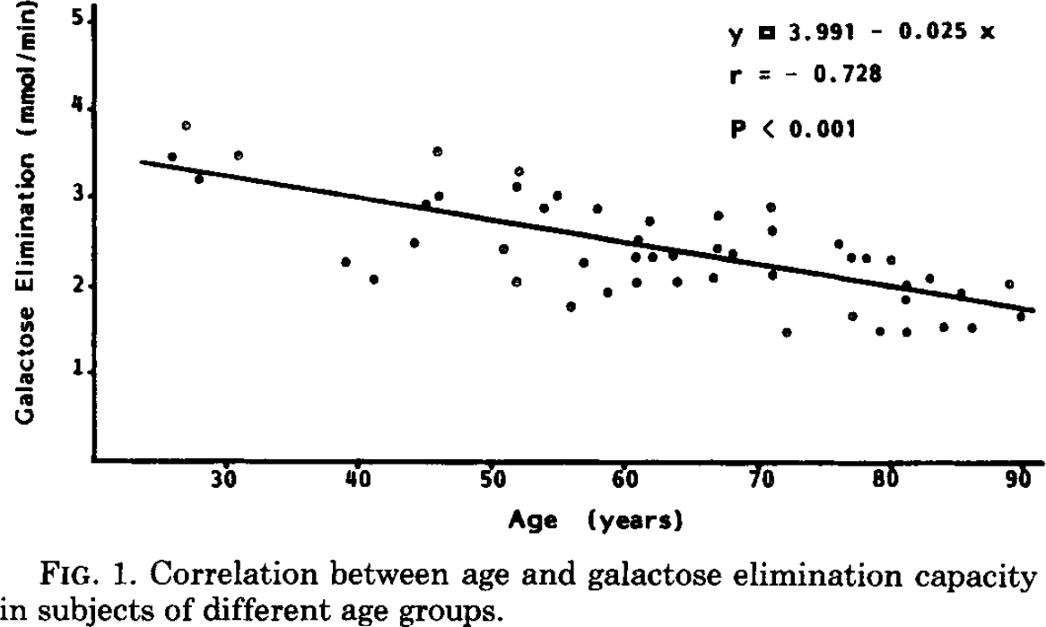
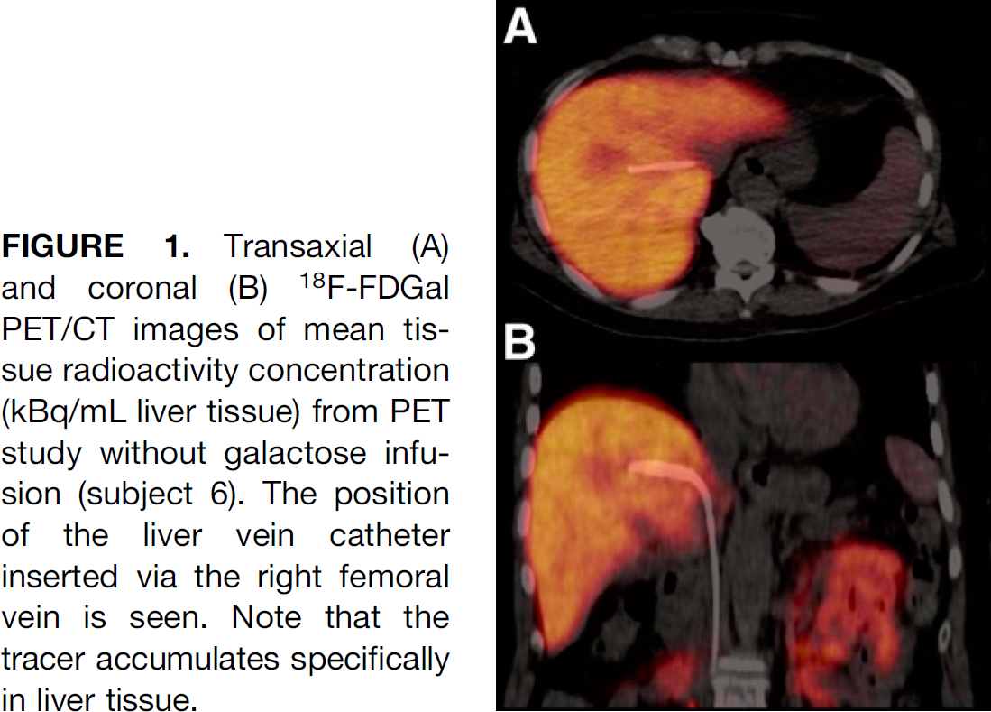
Current WORK
Predict alterations
GEC in aging
Cirrhosis
Analyse galactosemias
Use spatially resolved PET data (individual subjects)
Normal
cirrhosis

Slide 16
What I learned … so far
Multiscale requires data management
only reproducible results are results
Database layer decouples simulation & analysis
Structured/standard formats function as model unit tests
Multiscale relies on units
a model without units is no model (what is the meaning of parameters and componets?)
automatic unit checks as model unit tests
Units do the modelling for you (tell you how the system produces the quantity)
Multiscale is difficult & more easy
Hierarchical constraints fix parameters
Every scale provides a new set of experimental data
Multiscale-errors (!)
The more scales the more obscure the errors
Visualize everything

Slide 17
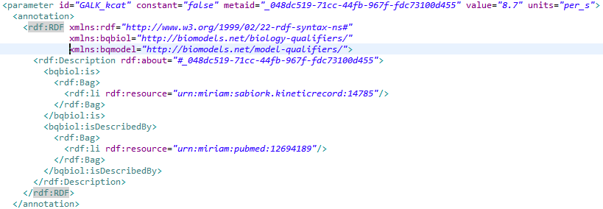
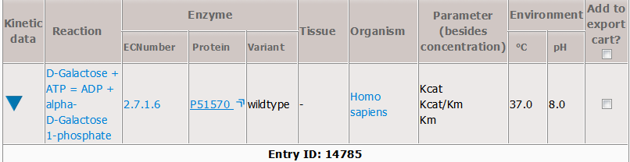
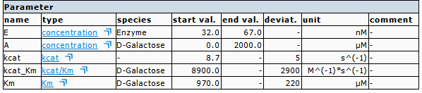
Processes
Galactokinase
SBML Model
http://seek.virtuelle-leber.de/models/138
Annotations
CHEBI, UniProt, KEGG, RHEA
kinetic parameters linked to SABIO-RK

Slide 18
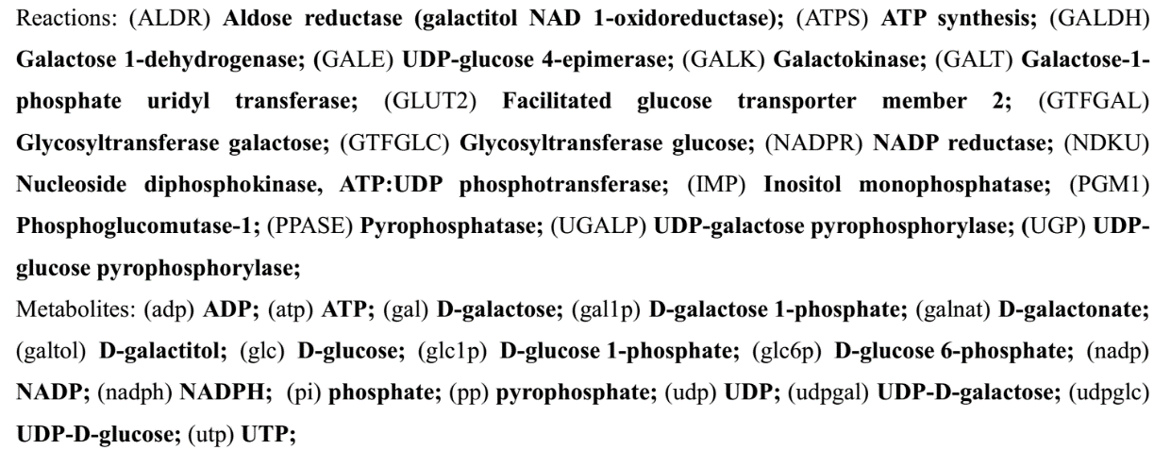

Slide 19
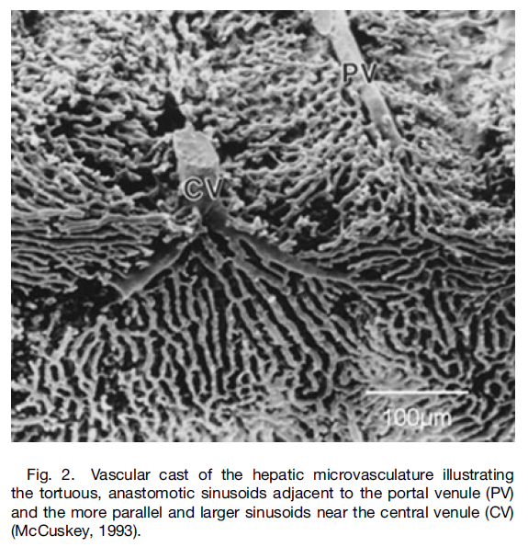
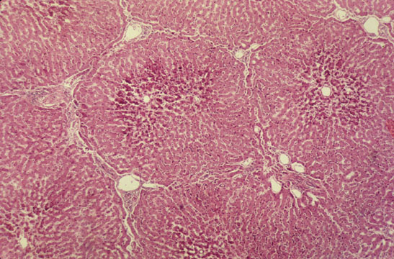

Slide 20
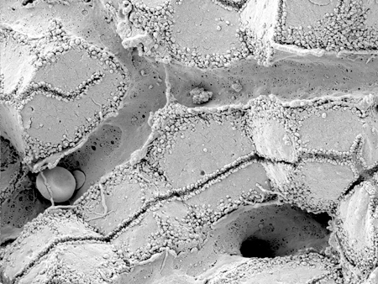
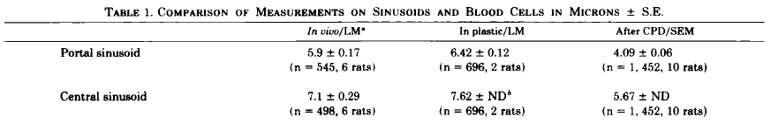
Sinusoid
Scanning electron micrograph showing fenestrated sinusoids and hepatocytes in a mouse liver.
http://www.easloffice.eu/jhep/contest/website/see_photos.html
principal vessels for exchange between blood and hepatocytes
~ 6-8µm diameter
periportal sinusoids are narrower and more tortuous than the wider and straighter central ones
Sinusoid network is heterogeneous
near portal vene arranged as interconnecting polygonal networks
farther away from portal vein organized as parallel vessels terminating in the central vein
short intersinusoidal sinusoids connect adjacent parallel sinusoids
Scanning electron microscope observations on the structure of portal veins, sinusoids and central veins in rat liver. Wisse, E.; De Zanger, R. B.; Jacobs, R. & McCuskey, R. S.; Scan Electron Microsc, 1983, 1441-1452
The liver sieve: considerations concerning the structure and function of endothelial fenestrae, the sinusoidal wall and the space of Disse. Wisse, E.; De Zanger, R. B.; Charels, K.; Van Der Smissen, P. & McCuskey, R. S. Hepatology, 1985, 5, 683-692

Slide 21
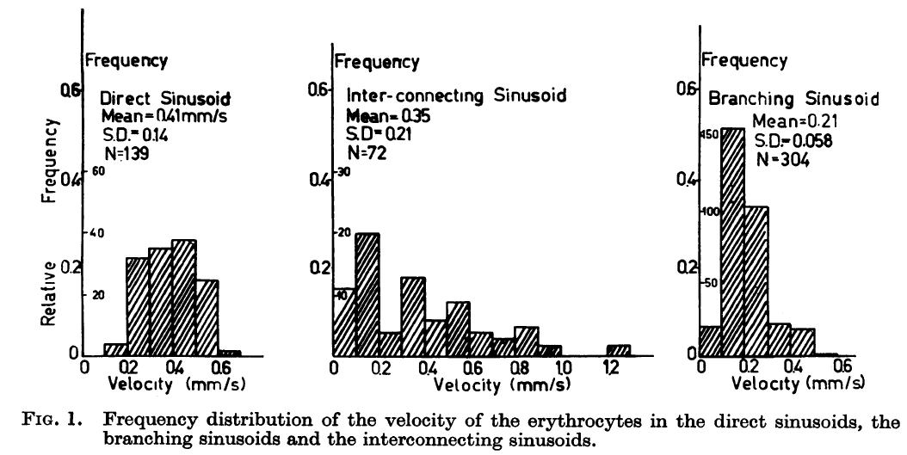
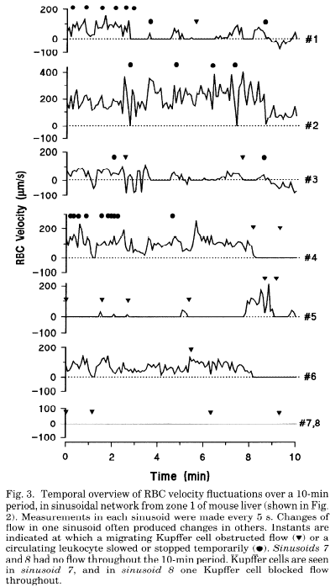
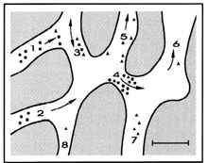
Blood Flow
The terminal hepatic microcirculation in the rat. Koo, A.; Liang, I. Y. & Cheng, K. K.; Q J Exp Physiol Cogn Med Sci, 1975, 60, 261-266
Intermittence of blood flow in liver sinusoids, studied by high-resolution in vivo microscopy. MacPhee, P. J.; Schmidt, E. E. & Groom, A. C.; 1995, 269, G692-G698

Slide 22
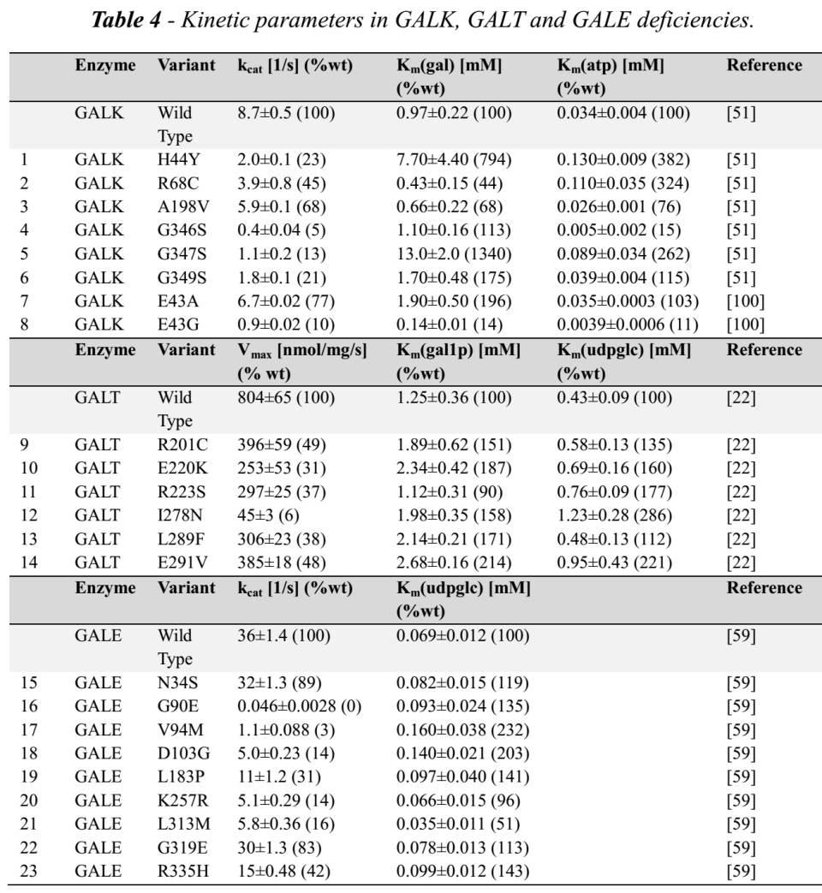
Galactosemias
caused by deficiencies in either GALK, GALT or GALE
untreated as well as treated patients with galactosemia show accumulation and/or depletion of specific metabolites, and often abnormalities of glycosylation
implementation
via measured alterations in kinetic properties in human protein mutations

Slide 23
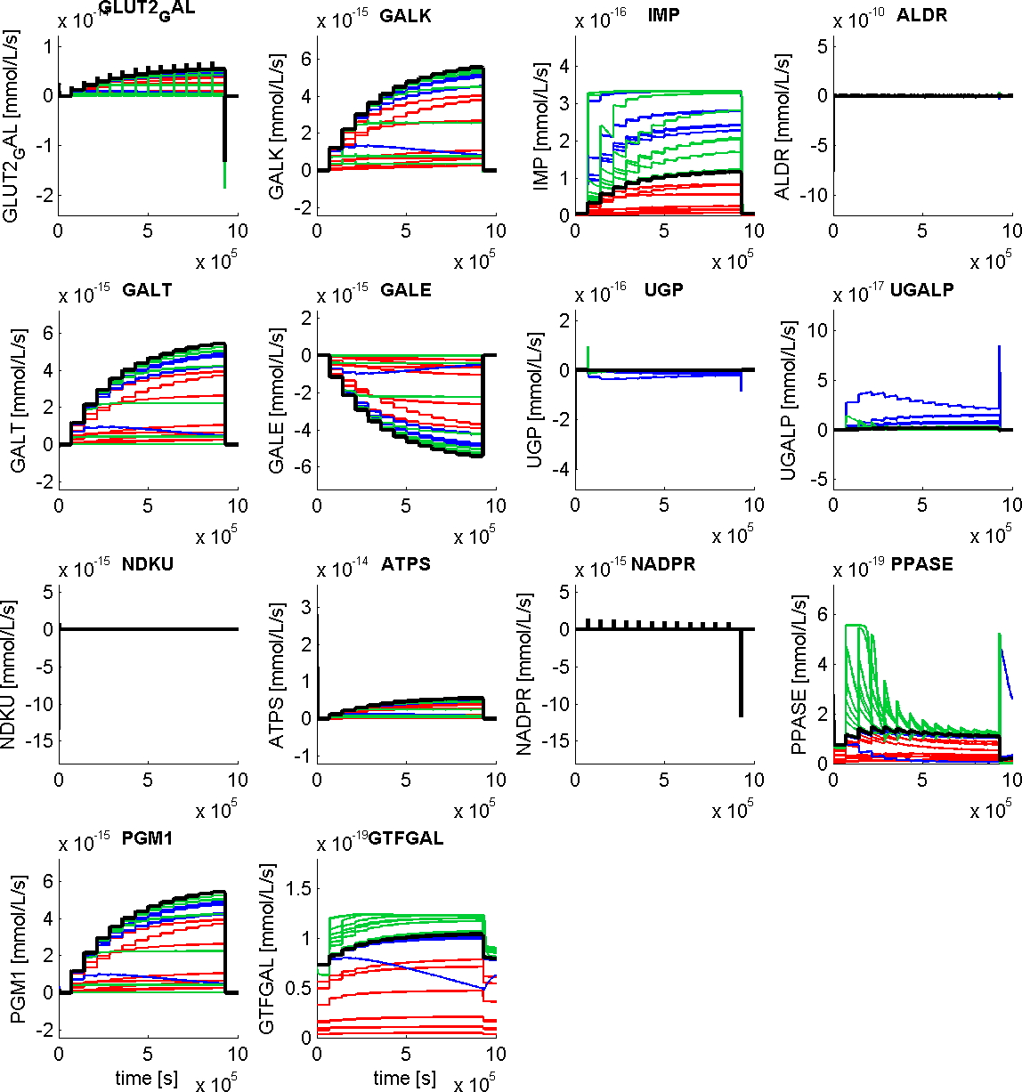
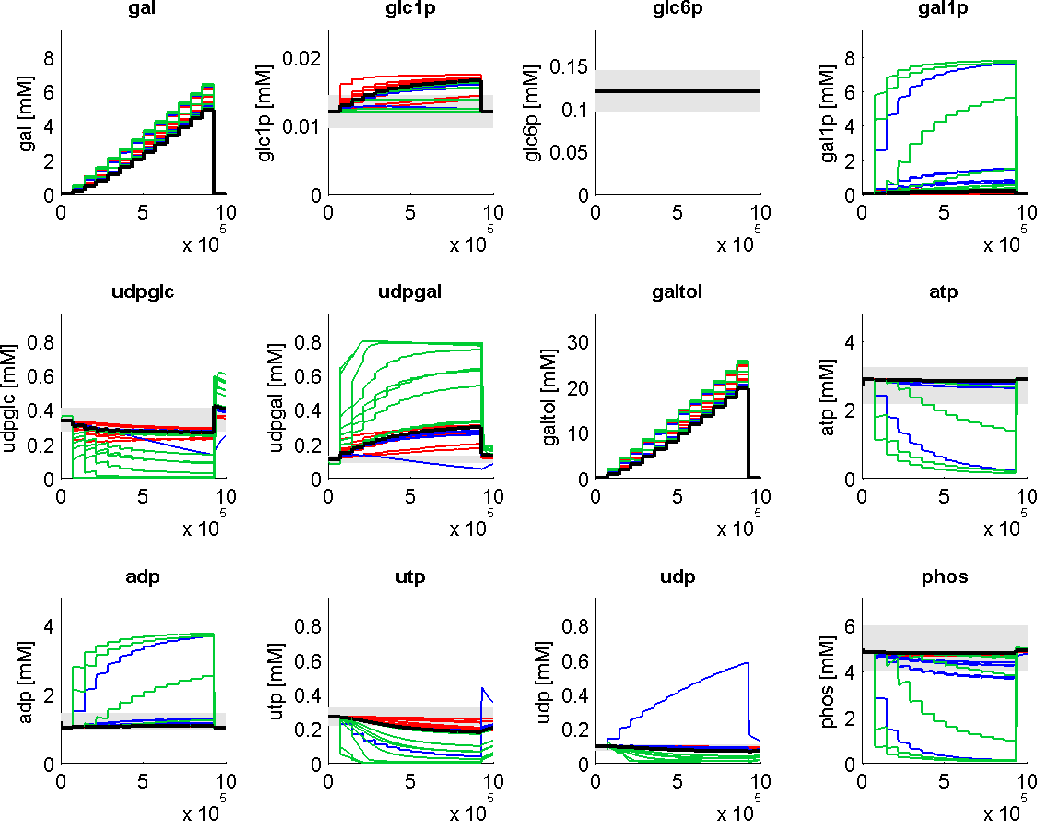
Galactosemia (GALK, GALT, GALE)
marked alterations in metabolite levels
galactitol accumulation
shift of udpglc/udpgal level
reduced galactose clearance
energetically challenged

